Slide 1
Light Monitoring
Shabrya Lott

Slide 2
Goal
Main Goal Visually display a high dynamic digital light sensor’s data using BeagleBone Black
Sub-Goals: -Interface TSL2591 with BeaglBone Black with I2C
-Interface ESP8266 with BeagleBone Black with UART
-Upload data to ThingSpeak in C

Slide 3
Accomplishments
TSL2591 communicates to BBB using I2c
Data was able to be uploaded to ThingSpeak.com via TCP socket and BBB connected to router

Slide 4
Components Used in Design
BeagleBone Black Rev C
TSL2591 (Lux Sensor)
Router with Ethernet Cable
1x BreadBoard
USB MiniB to USB A connector
Jumper Wires

Slide 5
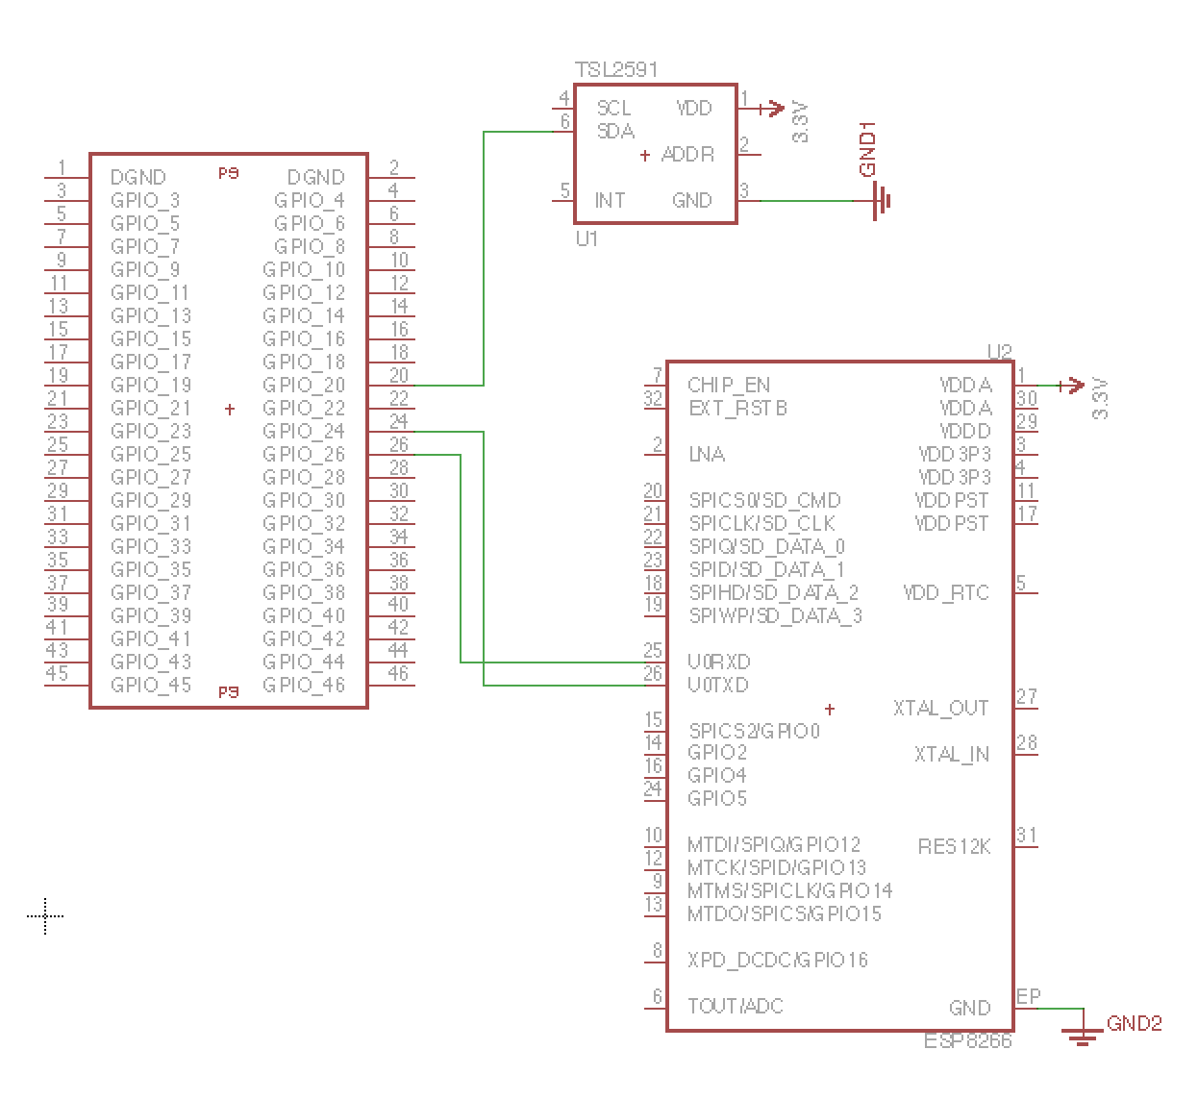
Schematic

Slide 6
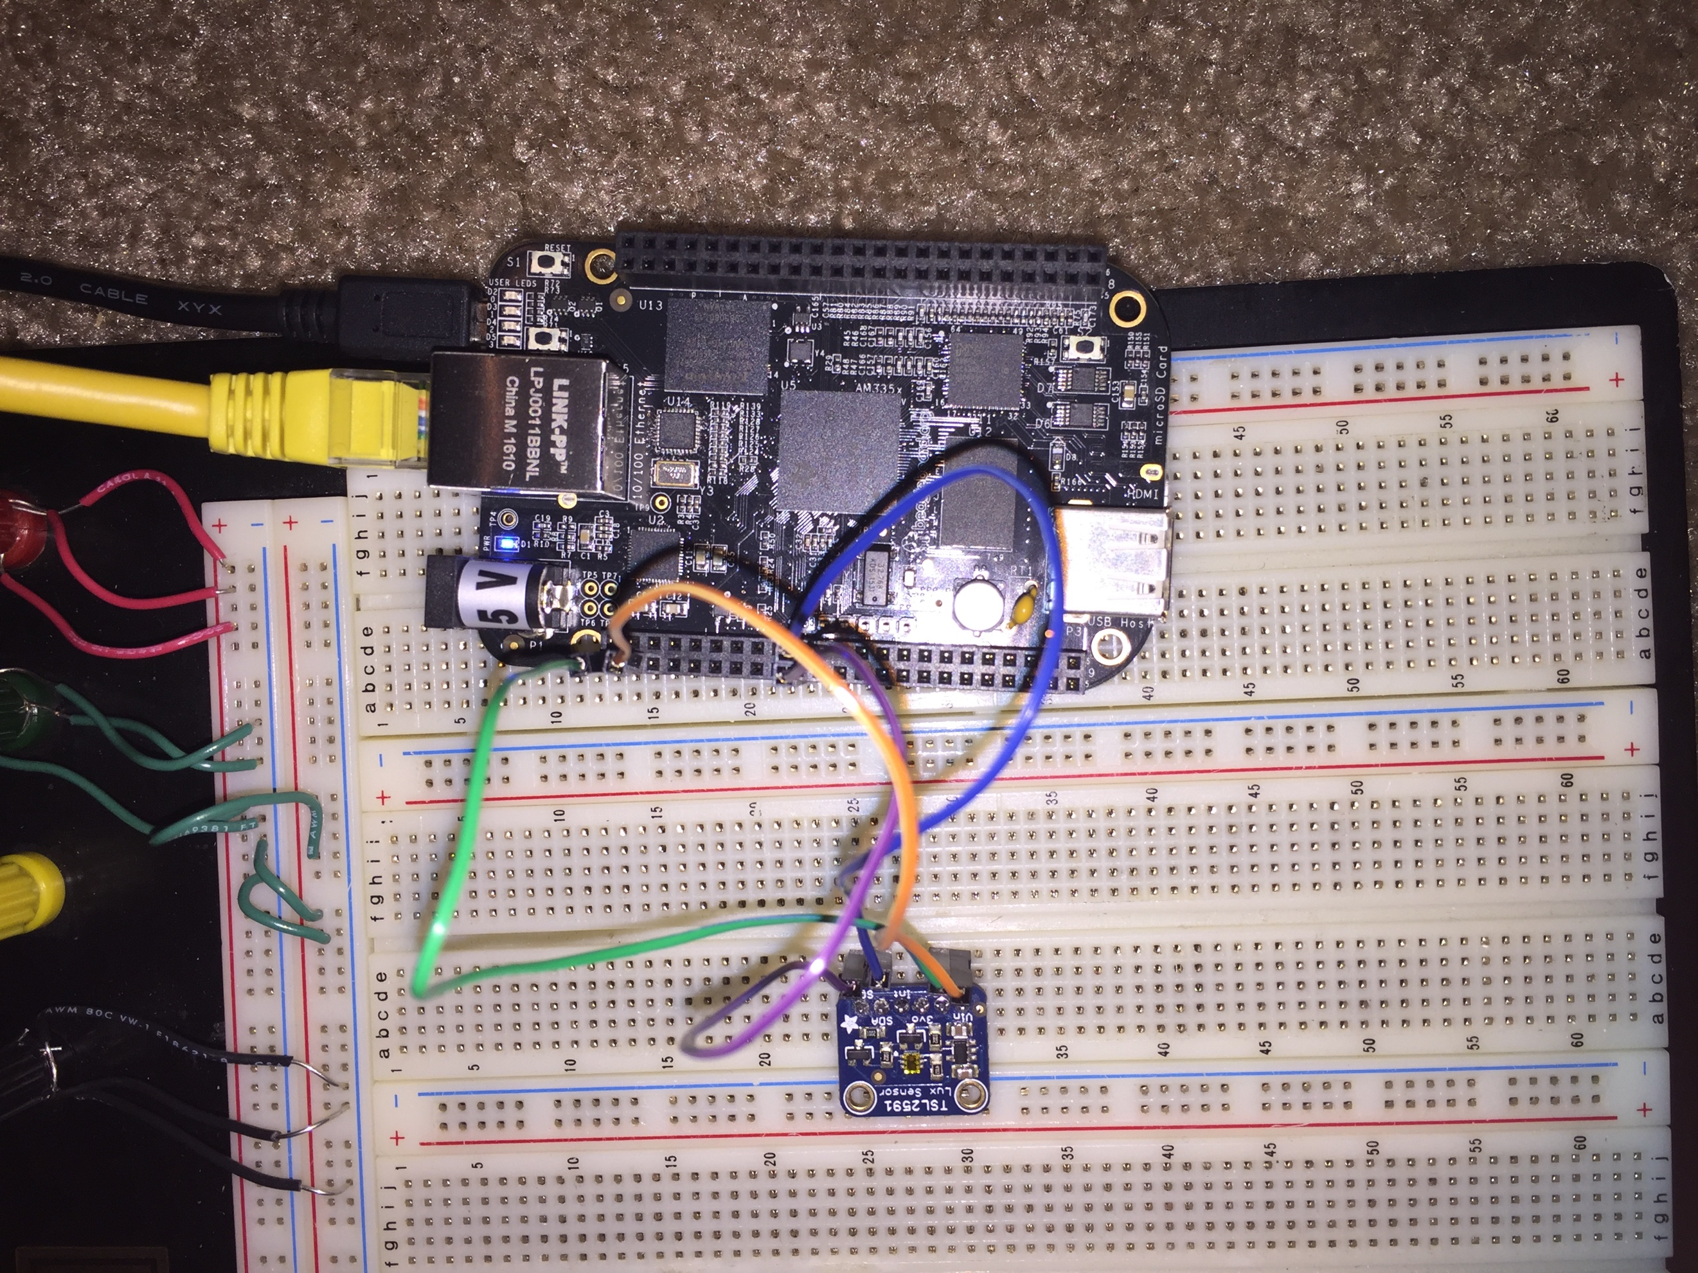
Actual Layout

Slide 7
Tools Used in Design
EAGLE: Used for creating the schematic of the project.
Debian(BeagleBone Black): Stored on a microSD card and then was burned to the on board eMMC by inserting the SD card into (powered-down) board, hold switch S2 (Boot Switch)down by pressing on it and holding it while plugging in the power cable. Continued to hold the button until the first User LED came on.
I2C ToolSet: Used for ensuring information gathered from the sensor was correct and could determine the correct registers were being read.
SSH Secure Shell: Use to store and transfer project files
ThingSpeak.com: Used to visually display the sensor data

Slide 8
Implementation Details
The TSL2591 sensor used the SDA and SCL pins which were connected to P9.20 and P9.19 on the BeagleBone Black. The sensor was powered by the 3.3V (pin 3 on BBB)and grounded by Pin 1 on the BBB. The sensor communicated to the BBB by the opening of the i2C-2 and the address being sent to acquire the bus in the code.
The function, TSL2591_INIT() sent command bits to set the timing, gain, and to power the sensor on.
GetFullLumnosity() is a subroutine that actually reads raw data from CH0 and CH1 of the sensor, calculates the lux and then send the final value back to main.
SendDataToThingSpeak() function takes the lux value and uses a TCP socket to communicate and send data to ThingSpeak.

Slide 9
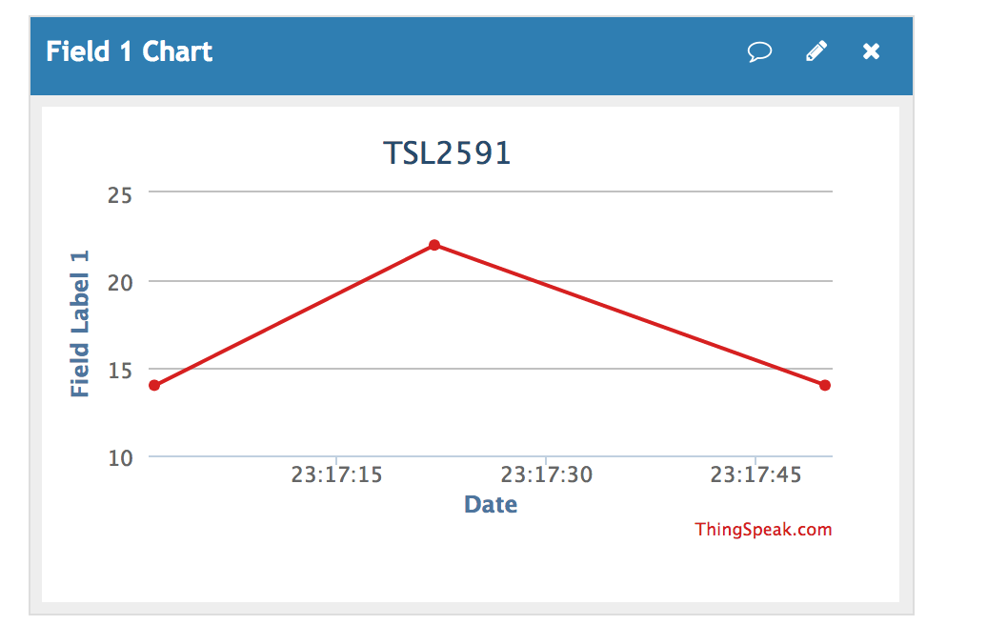
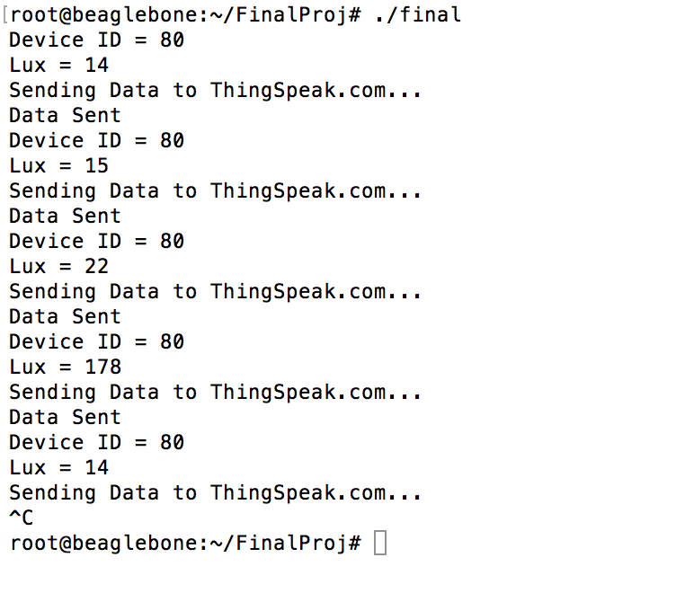
Demo
Video link: https://youtu.be/drhbZQ1cCzQ

Slide 10
Results and Conclusions
In conclusion, almost all the goals were met and demonstrated. Interfacing the sensor to the BeagleBone black was simple, but interfacing the BBB to a Wi-Fi module was difficult.
I discovered there is alternative way to push data to ThingSpeak via TCP socket.
The TSL2591 can be used for many applications that deal with light monitoring such as printer detection, keyboard illumination control, and ambient light sensing (ALS) for mobile handsets, tablets, notebooks, TVs and monitors.

Slide 11
References
Downloading Instructions: https://sites.google.com/a/unlv.edu/unlvcpe403f16/
I2C: https://makingaquadrotor.wordpress.com/2012/07/08/i2c-on-the-beaglebone/
TCP Socket https://github.com/phfbertoleti/ThingSpeakC

